Slide 1
Machine Learning with R
Basics of Machine learning

Slide 2
What is Machine Learning
Development of computer algorithms for transforming data into intelligent action is known as machine learning.
A closely related sibling of machine learning, data mining, is concerned with the generation of novel insight from large databases
machine learning tends to be focused on performing a known task, whereas data mining is about the search for hidden nuggets of information.
For instance, you might use machine learning to teach a robot to drive a car, whereas you would utilize data mining to learn what type of cars are the safest.

Slide 3
Uses of Machine Learning
Target advertising to specific types of consumers
Predict the outcomes of elections
Identify and filter spam messages from e-mail
Foresee criminal activity
Automate traffic signals according to road conditions
Produce financial estimates of storms and natural disasters
Examine customer churn
Create auto-piloting planes and auto-driving cars
Identify individuals with the capacity to donate

Slide 4
How Machine Learning Works
A machine learning algorithm takes data and identifies patterns that can be used for action.
Regardless of whether the learner is a human or a machine, the basic learning process is similar. It can be divided into three components as follows:
Data input: It utilizes observation, memory storage, and recall to provide a factual basis for further reasoning.
Abstraction: It involves the translation of data into broader representations.
Generalization: It uses abstracted data to form a basis for action.

Slide 5
Machine Learning Model
During the process of knowledge representation, the computer summarizes raw inputs in a model, an explicit description of the structured patterns among data.
There are many different types of models. You may already be familiar with some.Examples include:
• Equations
• Diagrams such as trees and graphs
• Logical if/else rules
• Groupings of data known as clusters

Slide 6
Steps
The process of fitting a particular model to a dataset is known as training.
When the model has been trained, the data has been transformed into an abstract form that summarizes the original information.
Banks might discover a seemingly innocuous type of transaction that systematically appears prior to fraudulent activity
psychologists might identify a combination of characteristics indicating a new disorder

Slide 7
learning process is not complete until the learner is able to use its abstracted knowledge for future action.
The term generalization describes the process of turning abstracted knowledge into a form that can be utilized for action.
The heuristics employed by machine learning algorithms also sometimes result in erroneous conclusions. If the conclusions are systematically imprecise, the algorithm is said to have a bias.
For example, suppose that a machine learning algorithm learned to identify faces by finding two circles, or eyes, positioned side-by-side above a line for a mouth.

Slide 8
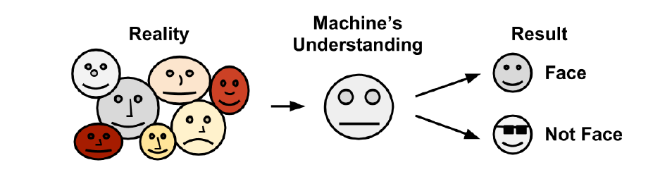
Bias is a necessary evil associated with the abstraction and generalization process inherent in any machine learning task.
Every learner has its weaknesses and is biased in a particular way; there is no single model to rule them all.

Slide 9
After a model has been trained on an initial dataset, the model is tested on a new dataset, and judged on how well its characterization of the training data generalizes to the new data.
Failure for models to perfectly generalize is due to the problem of noise, or unexplained variations in data.
Errors caused when data is recorded incorrectly, including missing, null, truncated, incorrectly coded, or corrupted values

Slide 10
Trying to model the noise in data is the basis of a problem called overfitting.
Because noise is unexplainable by definition, attempting to explain the noise will result in erroneous conclusions that do not generalize well to new cases.
Model that seems to perform well during training but does poorly during testing is said to be over fitted to the training dataset as it does not generalize well.

Slide 11
Steps to apply machine learning to your data
Collecting data
Exploring and preparing the data: The quality of any machine learning project is based largely on the quality of data it uses
Training a model on the data
Evaluating model performance
Improving model performance
After these steps have been completed, if the model appears to be performing satisfactorily, it can be deployed for its intended task.

Slide 12
Choosing a machine learning algorithm
Machine learning algorithm is largely dependent upon the type of data you are analyzing and the proposed task at hand
All machine learning algorithms require input training data. The exact format may differ, but in its most basic form, input data takes the form of examples and features.
If you were building a learning algorithm to identify spam e-mail, the examples would be data from many individual electronic messages.
To detect cancerous tumors, the examples might comprise biopsies from a number of patients.

Slide 13
A feature is a characteristic or attribute of an example, which might be useful for learning the desired concept.
In the previous examples, attributes in the spam detection dataset might consist of the words used in the e-mail messages.
For the cancer dataset, the attributes might be genomic data from the biopsied cells, or measured characteristics of the patient such as weight, height, or blood pressure.

Slide 14
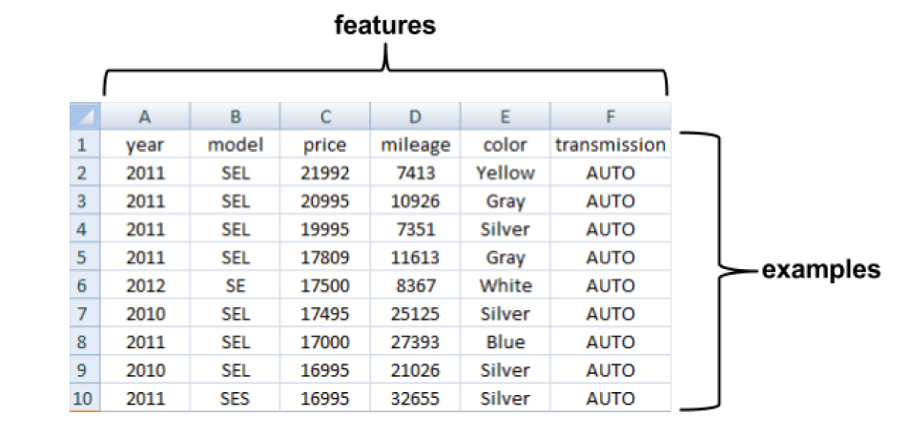
The rows indicate examples of automobiles while the columns record various features of the cars such as the price, mileage, color, and transmission.
Matrix format data is by far the mostcommon form used in machine learning

Slide 15
Types of Feature
Features come in various forms as well. If a feature represents a characteristic measured in numbers, it is unsurprisingly called numeric.
Alternatively, if it measures an attribute that is represented by a set of categories, the feature is called categorical or nominal.
A special case of categorical variables is called ordinal, which designates a nominal variable with categories falling in an ordered list.
Some examples of ordinal variables include clothing sizes such as small, medium, and large, or a measurement of customer satisfaction on a scale from 1 to 5.

Slide 16
Thinking about types of machine learning algorithms
Machine learning algorithms can be divided into two main groups:
Supervised learners that are used to construct predictive models, and
unsupervised learners that are used to build descriptive models.

Slide 17
Supervised Learning
A predictive model is used for tasks that involve, as the name implies, the prediction of one value using other values in the dataset. The learning algorithm attempts to discover and model the relationship among the target feature (the feature being predicted) and the other features.
Because predictive models are given clear instruction on what they need to learn and how they are intended to learn it, the process of training a predictive model is known as supervised learning

Slide 18
The often used supervised machine learning task of predicting which category an example belongs to is known as classification. It is easy to think of potential uses for a classifier. For instance, you could predict whether:
A football team will win or lose
A person will live past the age of 100
An applicant will default on a loan
An earthquake will strike next year
The target feature to be predicted is a categorical feature known as the class and is divided into categories called levels.

Slide 19
Supervised learners can also be used to predict numeric data such as income, laboratory values, test scores, or counts of items. To predict such numeric values, a common form of numeric prediction fits linear regression models to the input data.

Slide 20
Unsupervised Learning
A descriptive model is used for tasks that would benefit from the insight gained from summarizing data in new and interesting ways.
As opposed to predictive models that predict a target of interest; in a descriptive model, no single feature is more important than any other.
In fact, because there is no target to learn, the process of training a descriptive model is called unsupervised learning.

Slide 21
pattern discovery is used to identify frequent associations within data.
Pattern discovery is often used for market basket analysis on transactional purchase data. Here, the goal is to identify items that are frequently purchased together

Slide 22
The descriptive modeling task of dividing a dataset into homogeneous groups is called clustering. This is sometimes used for segmentation analysis that identifies groups of individuals with similar purchasing, donating, or demographic information so that advertising campaigns can be tailored to particular audiences.
For example, given five different clusters of shoppers at a grocery store, the marketing team will need to understand the differences among the groups in order to create a promotion that best suits each group.

Slide 23
Comprehensive R Archive Network (CRAN)
collection of web and FTP sites located around the world to provide the most up-to-date versions of R software and R packages for download.

Slide 24
In many cases, input data is complex, messy, and spread across multiple sources and formats.
Because of this complexity, the largest portion of effort invested in machine learning projects is spent on the data preparation and exploration process.

Slide 25
R data structures
There are numerous types of data structures across programming languages, each with strengths and weaknesses specific to particular tasks.
The R data structures used most frequently in machine learning are vectors, factors, lists, arrays, and data frames.
Each of these data types is specialized for a specific data management task, which makes it important to understand how they will interact in your R project.

Slide 26
Vectors
The fundamental R data structure is the vector, which stores an ordered set of values called elements.
A vector can contain any number of elements.
However, all the elements must be of the same type; for instance, a vector cannot contain both numbers and text.

Slide 27
Types of Vector
There are several vector types commonly used in machine learning:
Integer (numbers without decimals)
numeric (numbers with decimals)
character (text data)
logical (TRUE or FALSE values)
There are also two special values:
NULL, which is used to indicate the absence of any value
and NA, which indicates a missing value

Slide 28
It is tedious to enter large amounts of data manually,
Simple vectors can be created by using the combine function c().
The vector can also be given a name using the arrow <- operator, which is R's assignment operator
It is used in a similar way to the = assignment operator in many other programming languages

Slide 29
For example, let's construct a set of vectors containing data on three medical patients
subject_name <- c("John Doe", "Jane Doe", "Steve Graves")
temperature <- c(98.1, 98.6, 101.4)
flu_status <- c(FALSE, FALSE, TRUE)

Slide 30
Because R vectors are inherently ordered, the records can be accessed by counting the item's number in the set, beginning at 1, and surrounding this number with square brackets (for example, [ and ]) after the name of the vector.
> temperature[2]
[1] 98.6
A range of values can be obtained using the colon operator
> temperature[2:3]
[1] 98.6 101.4

Slide 31
Or Using Logical values:
temperature[c(TRUE, TRUE, FALSE)]
[1] 98.1 98.6
the vector provides the foundation for many other R data structures.

Slide 32
Factors
features that represent a characteristic with categories of values are known as nominal.
a character vector to store nominal data, R provides a data structure known as a factor specifically for this purpose.
In the medical dataset, we might use a factor to represent gender, because it uses two categories: MALE and FEMALE

Slide 33
Why not use character vectors?
An advantage of using factors is that they are generally more efficient than character vectors because the category labels are stored only once.
Rather than storing MALE, MALE, FEMALE, the computer may store 1, 1, 2. This can save memory.
Coding categorical variables as factors ensures that the model will treat this data appropriately.

Slide 34
> gender <- factor(c("MALE", "FEMALE", "MALE"))
> gender
[1] MALE FEMALE MALE
Levels: FEMALE MALE
When factors are created, we can add additional levels that may not appear in the data. Suppose for blood type
blood <- factor(c("O", "AB", "A"), levels = c("A", "B", "AB", "O"))
> blood
[1] O AB A
Levels: A B AB O

Slide 35
Lists
Another special type of vector, a list, is used for storing an ordered set of values.
However, unlike a vector that requires all elements to be the same type, a list allows different types of values to be collected.

Slide 36
To illustrate lists, consider the medical patient dataset we have been constructing, with data for three patients stored in five vectors.
> subject_name[1]
[1] "John Doe"
> temperature[1]
[1] 98.1
> flu_status[1]
[1] FALSE
> gender[1]
[1] MALE
Levels: FEMALE MALE

Slide 37
This seems like a lot of work to display one patient's medical data
The list structure allows us to group all of a patient's data into one object we can use repeatedly
Similar to creating a vector with c(), a list is created using the list() function
> subject1 <- list(fullname = subject_name[1], temperature = temperature[1], flu_status = flu_status[1], gender = gender[1], blood = blood[1])

Slide 38
Printing a patient's data is now a matter of typing a single command:
> subject1
$fullname
[1] "John Doe"
$temperature
[1] 98.1
$flu_status
[1] FALSE
$gender
[1] MALE
Levels: FEMALE MALE

Slide 39
A list can be accessed using the same methods as a vector
the names give additional clarity for accessing the values, rather than needing to remember the position of the temperature value, like this:
> subject1[2]
$temperature
[1] 98.1
It is often easier to access temperature directly, by appending a $ and the value's name to the name of the list:
> subject1$temperature
[1] 98.1

Slide 40
It is possible to obtain several items in a list by specifying a vector of names:
> subject1[c("temperature", "flu_status")]
$temperature
[1] 98.1
$flu_status
[1] FALSE

Slide 41
Entire datasets could be constructed using lists (or lists of lists)
R provides a specialized data structure specifically for this task

Slide 42
Data frames
By far the most important R data structure utilized in machine learning is the data frame,
A structure analogous to a spreadsheet or database since it has both rows and columns of data.
In R terms, a data frame can be understood as a list of vectors or factors, each having exactly the same number of values.
Because the data frame is literally a list of vectors, it combines aspects of both vectors and lists.

Slide 43
For Example:
Using the patient data vectors we created previously, the data.frame() function combines them into a data frame:
> pt_data <- data.frame(subject_name, temperature, flu_status,
gender, blood, stringsAsFactors = FALSE)

Slide 44
parameter: stringsAsFactors = FALSE.
If we do not specify this option, R will automatically convert every character vector to a factor;
this a feature which is occasionally useful, but is also sometimes excessive.

Slide 45
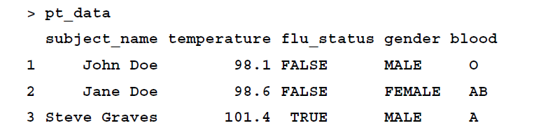

Slide 46
Compared to the one-dimensional vectors, factors, and lists, a data frame has two dimensions and it is therefore displayed in matrix format.
The data frame has one column for each vector of patient data and one row for each patient.
In machine learning terms, the columns are the features or attributes and the rows are the examples.

Slide 47
To extract entire columns (vectors) of data
> pt_data$subject_name
[1] "John Doe" "Jane Doe" "Steve Graves“
Similar to lists, the most direct way to extract a single element, in this case a vector or column of data, is by referring to it by name.

Slide 48
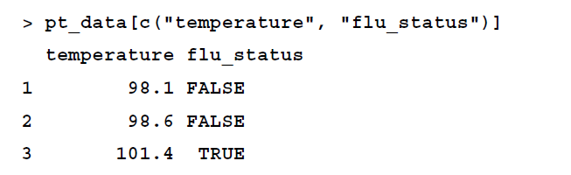
Also similar to lists, a vector of names can be used to extract several columns from a data frame:

Slide 49
because the data frame is two-dimensional, need to specify the position of both the rows and columns you would like to extract.
Rows are specified first, followed by a comma, followed bythe columns in a format like this: [rows, columns], starting from the number 1.
> pt_data[1, 2]
[1] 98.1

Slide 50
> pt_data[c(1, 3), c(2, 4)]
temperature gender
1 98.1 MALE
3 101.4 MALE
To extract all of the rows or columns simply leave the row or column portion blank
> pt_data[, 1]
[1] "John Doe" "Jane Doe" "Steve Graves"

